Slide 1
Basic Tissues

Slide 2
TISSUE [Fr. Tissu, Woven; L. Texo, to Weave]
is a group of structurally and functionally closely related cells and their product (intercellular substance = ECM) specialized to perform specific function(s).
Tissues are made of two interacting components: cells and intercellular substance known as extracellular matrix (ECM).
The ECM consists of many kinds of molecules, including fibers, ground substance (glycosaminoglycans, proteoglycans, glycoproteins) & tissue fluid.
Fibrillar ECM components usually organize and form complex structures, such as collagenous and elastic fibers bundles, external laminae and basement membranes.

Slide 3
The Four fundamental types of tissues are: epithelial tissue, connective tissue, muscle tissue, and nervous tissue.
Each of the fundamental tissues:
    is formed by several types of related cells and specific associations of cells and the extracellular matrix
    exists not as isolated units but rather in association with one another and in variable proportions, forming different organs and systems of the body.
These characteristic associations facilitate the recognition of the many subtypes of tissues.

Slide 4
The four basic types of tissues from superficial to deep are:
Epithelial tissue
Connective tissue
Nervous tissue
Muscle tissue

Slide 5
Objectives
Characterizing and identifying various types of tissues of the human body
    Epithelial tissue
    Connective tissue
    Muscular tissue
    Nervous tissue

Slide 6
Classification of Human Tissues
Epithelial tissue
Connective tissue
Muscular tissue
Nervous tissue

Slide 7
Tissues
There are four primary tissue types in the human body:
    Epithelial (membranous and glandular)
    Connective (supportive tissue)
    Muscle (movement)
    Nervous (control/communication)
These tissues differ in the types and functions of their cells, and the products of those cells and the relative distribution of the two.
Which picture on this slide corresponds to which tissue?

Slide 8
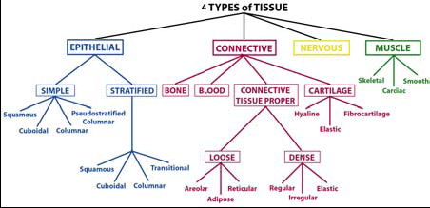

Slide 9
Table. Main Characteristics of the Four Basic Types of Tissues
Basic Tissues | Cells | Extracellular Matrix | Main Functions
Epithelial | Closely arranged polarized cells | Very small amount | Covering body surfaces, Lining tubes or body cavities, glandular secretion
Connective | Several types of fixed and wandering cells | Abundant amount | Support and protection
Muscle | Elongated contractile cells | Moderate amount | Movement
Nervous | Cells with Intertwining elongated processes | Lacks fibers, has only gelatinous ground substance | Transmission of nervous impulses

Slide 10
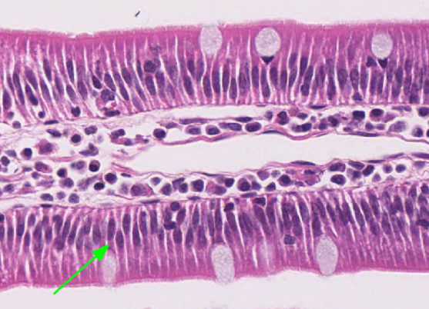
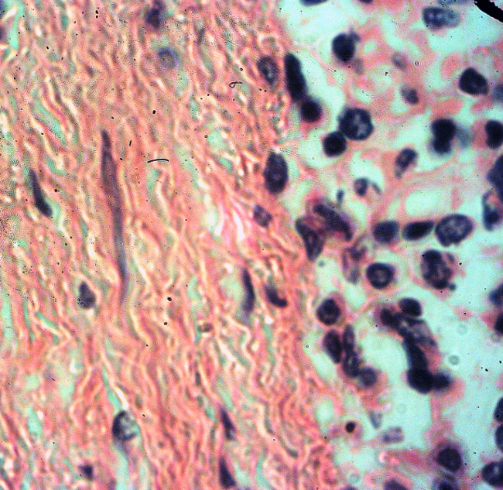
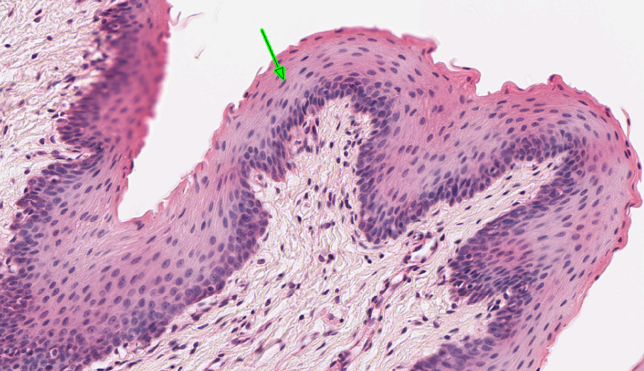

Slide 11
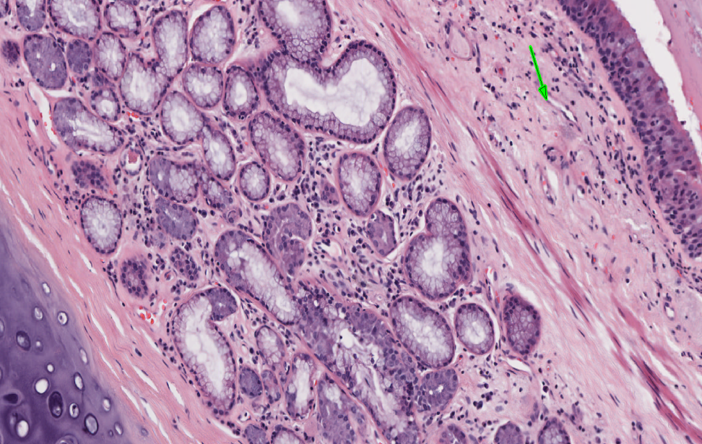
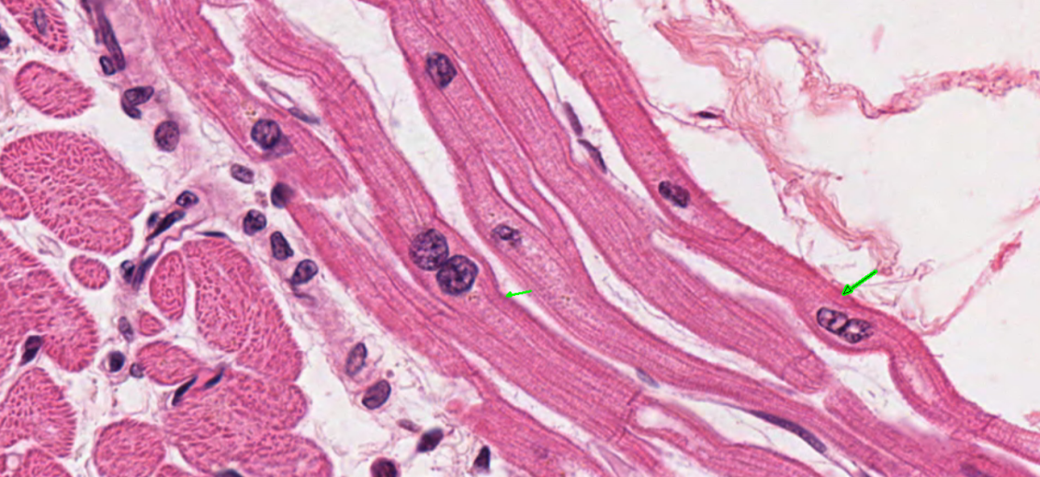
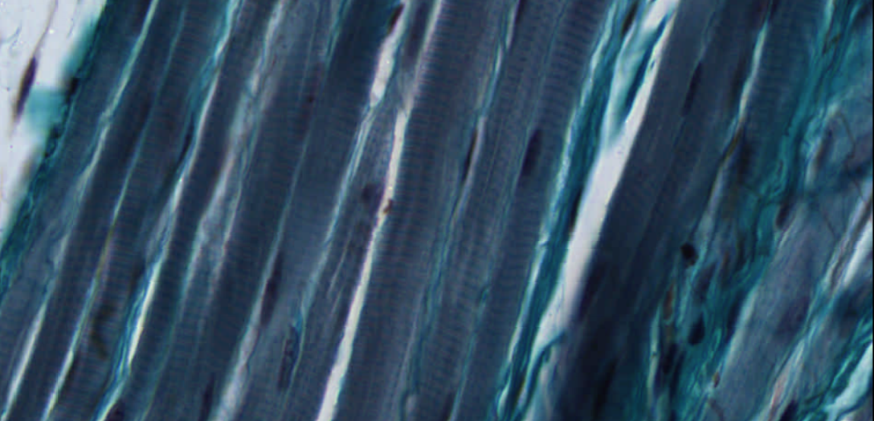
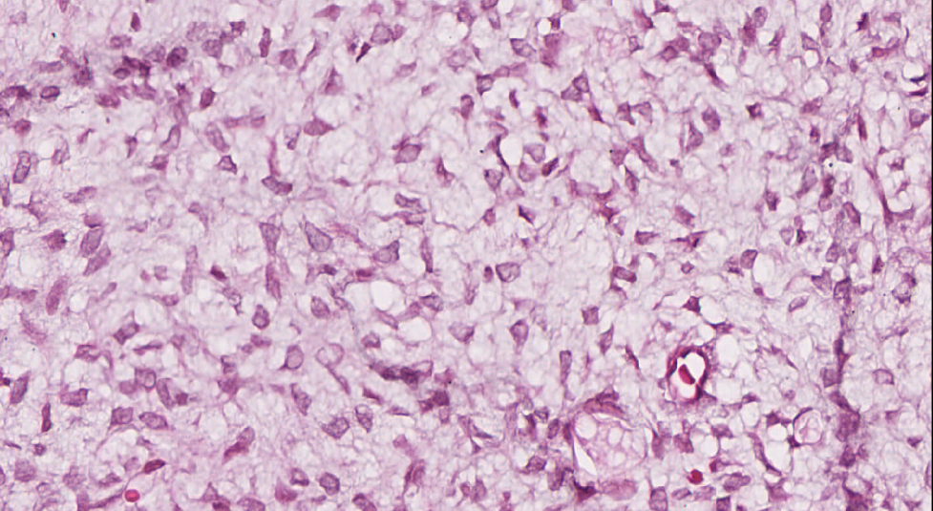
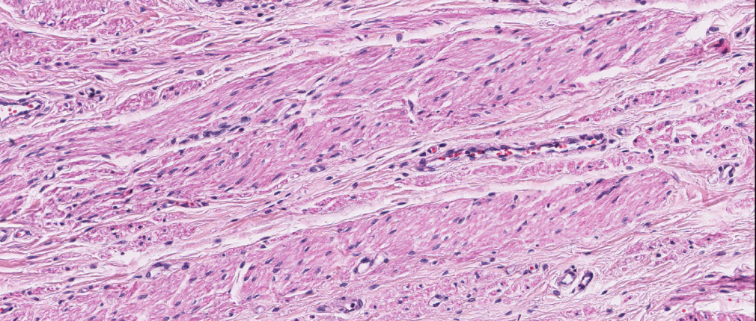
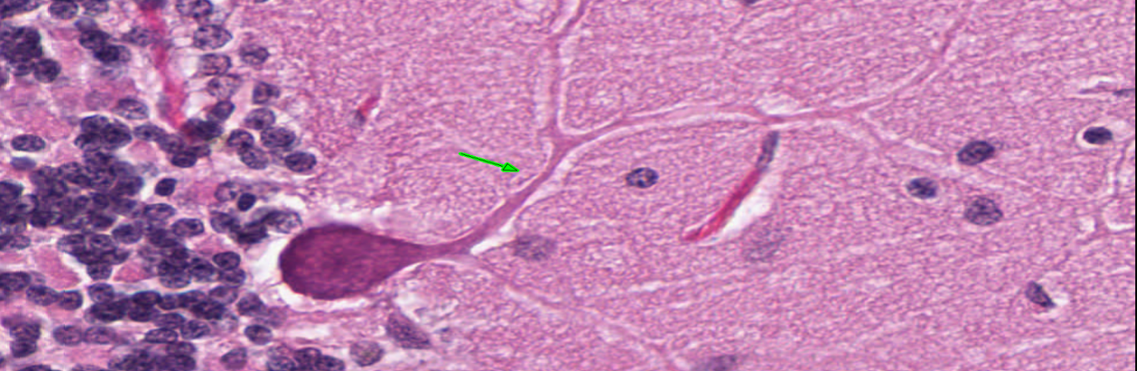
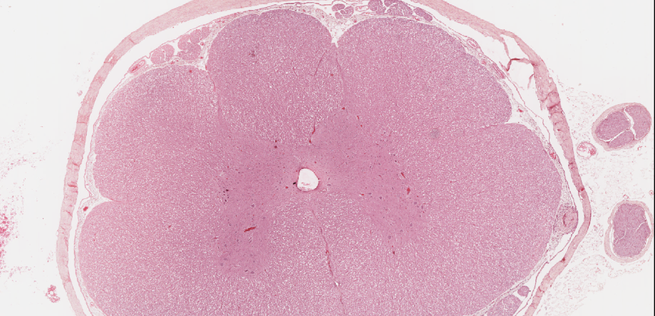

Slide 12
1. EPITHELIAL TISSUE/EPITHELIUM, ɛpi’Өi:liam
Introduction:
(Gk. epi, upon, + thele, "teat, nipple”)
is an avascular tissue composed of contagious cells that cover body surfaces or line closed cavities and tubes that communicate with the exterior (the alimentary, respiratory, and genitourinary tracts).
formed by a group of closely arranged cells with very little intercellular substance (ECM).
consists of continuous sheet of cells forming membranes which cover or line body structures or grouped as three-dimensional secretory units of glands.
the cells are highly cohesive,

Slide 13
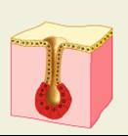
Epithelial tissue
Epithelial tissue is composed of crowded cells with very little intercellular substance. Cells are attached together by cell junctions
Epithelial tissue forms membranes that cover body surfaces or line body cavities
Epithelial tissue form glands [Exocrine OR Endocrine glands]
Epithelial tissue is avascular (NOT penetrated by blood and lymphatic vessels)
Function of Epithelium:
  Secretion
  Protection
  Absorption
  Gas exchange
Membrane
Gland

Slide 14
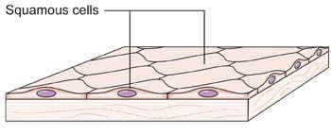
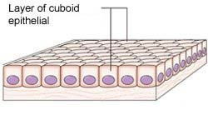
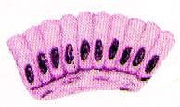
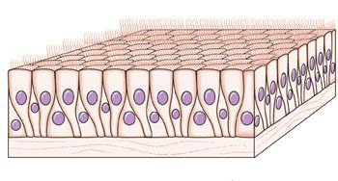
Epithelial tissue
Types of epithelial Tissues:
Simple Epithelia
(Formed of one row of cells)
According to the shape of cells
Simple squamous epithelium Single row of flattened cells with flattened nuclei rest on basement membrane
Simple cubical epithelium Single row of cubical cells with rounded nuclei rest on basement membrane
Simple columnar epithelium Single row of columnar cells with oval basal nuclei rest on basement membrane
Pseudostratified columnar epithelium

Slide 15
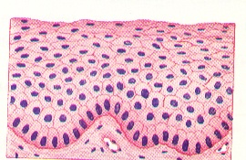
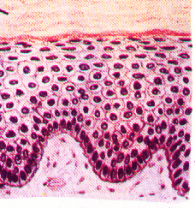
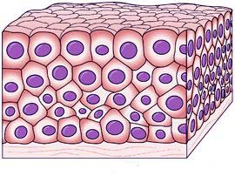
Epithelial tissue
Stratified epithelia
(Formed of two or more rows of cells)
According to the shape of surface cells
Stratified squamous epithelium
Stratified squamous keratinized epithelium
Transitional epithelium

Slide 16
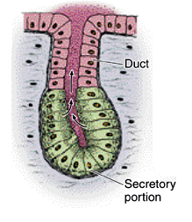
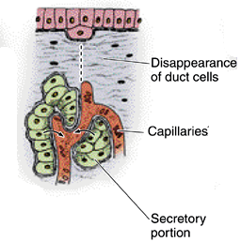
Epithelial tissue
Glandular epithelium:
Exocrine gland
Endocrine gland
Release secretion into the surface through a Duct
Example: Salivary glands
Have NO Duct
Release hormones
Released into blood stream
Example: Pituitary gland, thyroid gland,…..

Slide 17
Functions of Epithelial Tissue
Covers the surface of the body, lines the body cavities, forms the external and internal linings of most organs, and constitutes the bulk of most glands.
It’s found all over the body!
Functions include:
Protection
Absorption
Secretion
Filtration and diffusion
Sensory reception
Transcellular and surface transport
Above we have a section of skin. Where would the bulk of the epithelial tissue be found?

Slide 18
The principal functions of epithelial tissues are
Covering and lining of surfaces (e.g., skin covers the entire body, epithelial lining of intestines),
  Provides Protection--- from UV rays (e.g. Melanin), loss of fluid or desiccation (corneum), infection, friction (mechanical abrasion), etc.
Transcellular transport (transcytosis):
  Diffusion of gases (oxygen & carbon dioxide) across the epithelial cells of lung alveoli & capillaries.
  Carrier protein-mediated transport (e.g. digested food such as amino acids and glucose across intestinal epithelia)
  Vesicle-mediated transport (of IgA & other molecules)
Surface transport by cilia (e.g. mucus in respiratory system, ovum in uterus and oviduct)

Slide 19
Functions of epithelial tissues (Cont’ed)
Absorption: occurs via endocytosis or pinocytosis in various organs (e.g., the proximal convoluted tubules of kidneys)
Secretion: of various products (e.g., hormones, mucus, sweat, saliva, proteins, etc) by exocytosis,
Sensory functions (e.g., gustatory and olfactory neuroepithelium)
Contractility: e.g., myoepithelial cells
  epithelial cells specialized for high contractility
  found in sweat, salivary, lacrimal, & mammary glands to assist the process of their secretion mechanically.

Slide 20
Apical Modifications of Epithelial cells for different functions
The free or apical surface of many types of epithelial cells has specialized structures to increase the cell surface area or to move substances or particles on the surface.
1. Cilia
are elongated, highly motile cytoplasmic extensions of almost all cells, 2–10 µm long and 0.05–0.25 µm (50‒250 nm) in diameter, which are much longer & two times wider than a typical microvillus.
each cilium is bounded by the cell membrane and contains an axoneme with a central pair of microtubules surrounded by nine peripheral microtubular pairs.
Originate from the basal bodies, which are electron-dense structures in the apical cytoplasm at the apical pole just at the roots of the cilia.

Slide 21
Cilia
Basal bodies have a structure similar to that of centrioles.
In living organisms, cilia exhibit rapid back-and-forth movements coordinated to propel a current of fluid and suspended particles in one direction over the ciliated epithelium.
The motion occurs due to activity of ciliary dynein present on the peripheral microtubular doublets of the axoneme, with adenosine triphosphate (ATP) as the energy source.
A ciliated lining cell of the trachea can bear 250 to 300 cilia.
Three types of cilia: Typical cilia (perfectly motile), primary (nonmotile) and nodal cilia (motile).

Slide 22
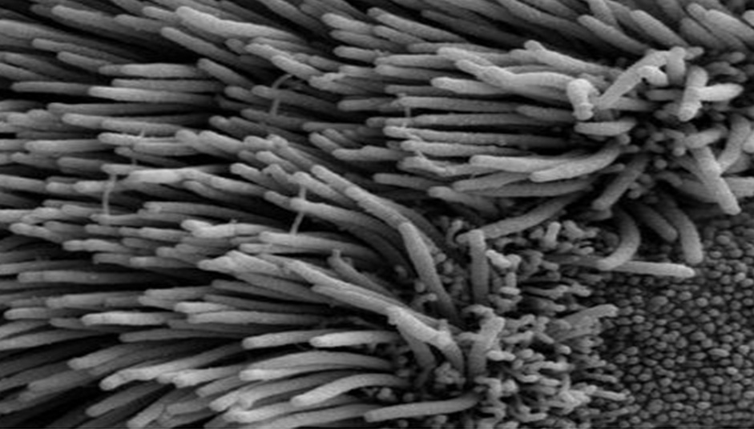
Cilia (red arrow) and Microvilli (blue arrow) on a tracheal cell

Slide 23
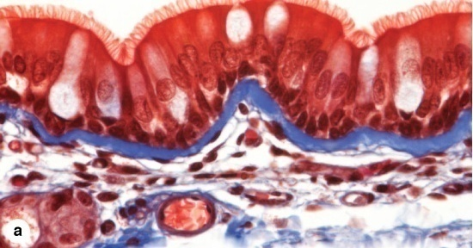
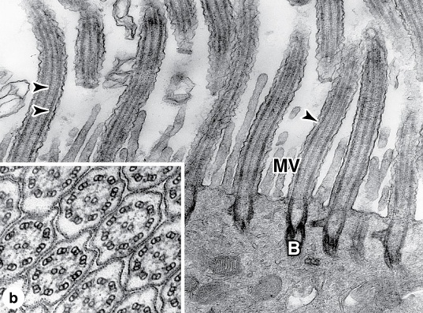
Ciliated (arrow head) lining epithelium of the trachea and 9+2 axoneme pattern of each cilium

Slide 24
2. Flagella
present only in spermatozoa
are apical elongation and modifications of immature cells known as spermatids by the cytodifferentiation known as spermiogenesis.
are similar in structure to cilia but are much longer and are normally limited to one flagellum per cell.
Sperm cells are the only flagellated human body cells

Slide 25
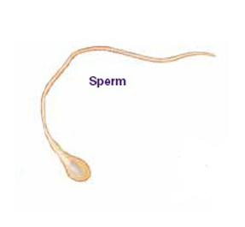
A human sperm cell

Slide 26
3. Microvilli
are short or long fingerlike cytoplasmic extensions or folds that pursue a sinuous course, and they range in number from a few to many.
most are temporary, reflecting cytoplasmic movements and the activity of actin filaments.
In absorptive cells, such as the lining epithelium of the small intestine, the apical surface presents orderly arrays of many hundreds of more permanent microvilli (L. villus, tuft), that appear as striated border.
The average microvillus is only about 1-3 µm high and 50-100 nm (0.1 µm) wide, but with hundreds or thousands present on the apical end of each absorptive cell, the total surface area can be increased as much as 20- or 30-fold.

Slide 27
Microvilli
    Each intestinal absorptive cell (enterocyte) can have as many as 3000 microvilli on its apical pole.
In these absorptive cells the glycocalyx is thicker than that of most cells and includes enzymes for the final stages of certain macromolecules' breakdown.
The complex of microvilli and glycocalyx is easily seen in the light microscope and is called the brush or striated border.
At the root of the microvilli is the terminal web (cuticular plate), a horizontal network of actin microfilaments, tropomyosin and myosin II stabilized by spectrin (468 kilodaltons), which also anchors the terminal web to the apical cell membrane.

Slide 28
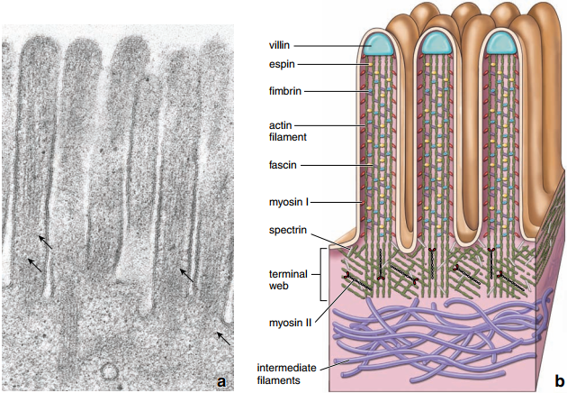
Molecular structure of microvilli

Slide 29
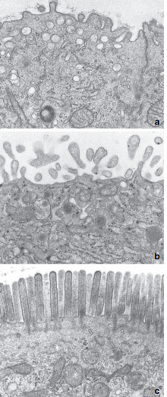
Abundance and size of microvilli on different types of tissues
Electron micrographs showing variation in
microvilli of different cell types. a. Epithelial cell of uterine gland; only very few small projections. b. Syncytiotrophoblast of placenta; irregular, branching blunt microvilli. c. Intestinal absorptive cell; uniform, numerous, and regularly arranged microvilli.

Slide 30
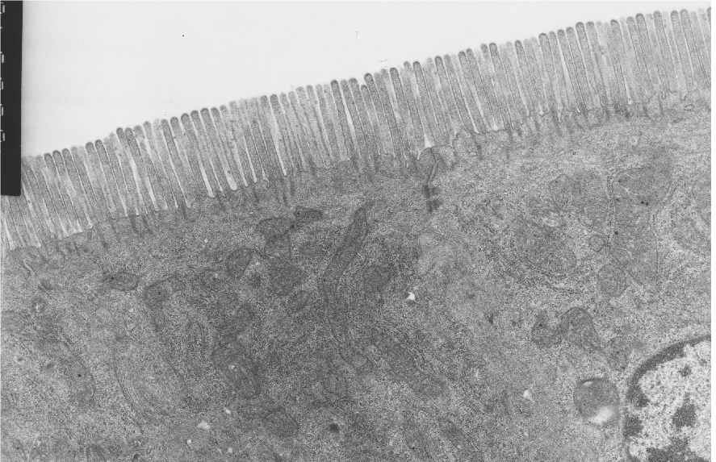
Abundant microvilli at the tip of intestinal absorptive cells
The microvilli of the intestinal epithelium (striated border) are the most highly ordered and most uniform in appearance than those of any other cells in the body.

Slide 31
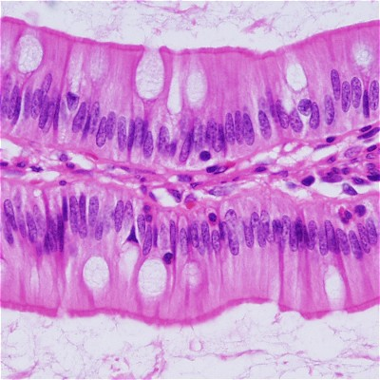
Microvilli appearing brush border on intestinal absorptive cells

Slide 32
4. Stereocilia/Stereovilli and kinocilia
are unusually long apical processes of cells (as long as 120 µm) and 100-150 nm in diameter in other absorptive cells such as lining epithelia of epididymis & ductus deferens, and also on hair cells (mechanoreceptors) of inner ear.
are much longer, sparse and less motile than microvilli, are branched, and should not be confused with true cilia.
Seen in the light microscope, resemble the hairs of a paint brush because of the way they aggregate and stick together in tufts of pointed bundles.
Like microvilli, stereocilia
  also increase the cells' surface area, facilitating the movement of fluid into and out of the cell.
  are supported by internal bundles of actin filaments that are cross-linked by fimbrin.

Slide 33
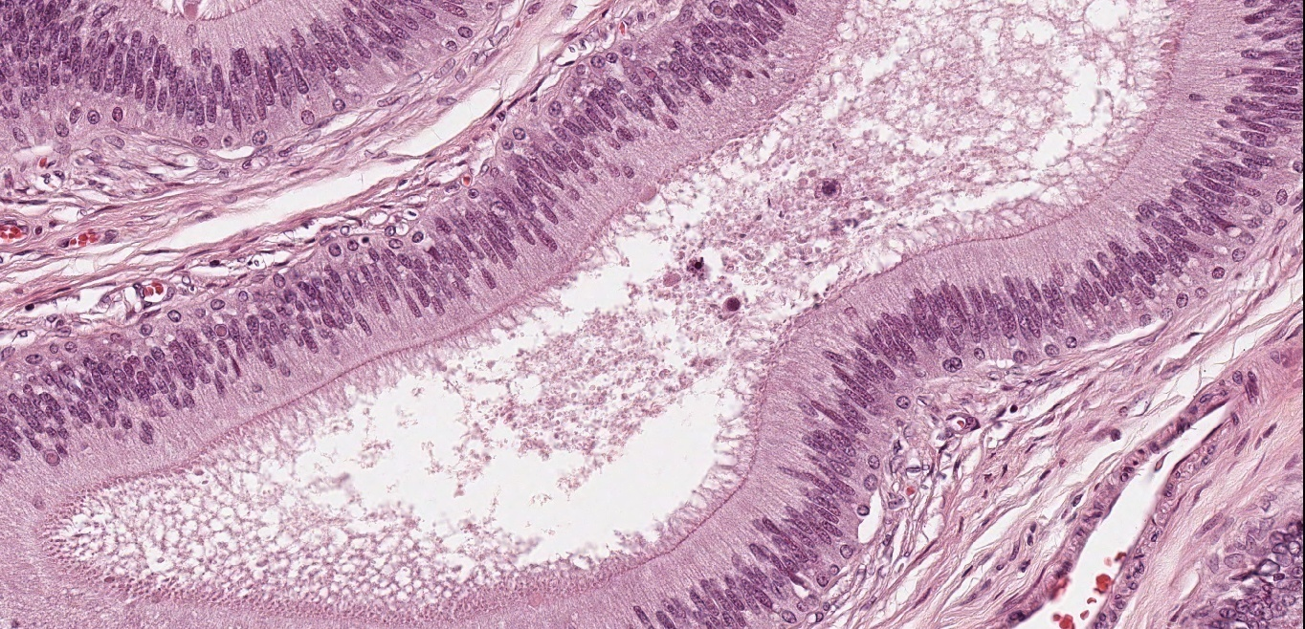
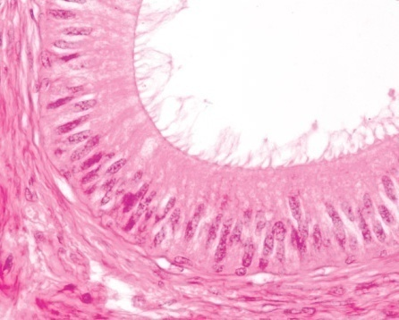
Stereocilia of Male genital ducts

Slide 34
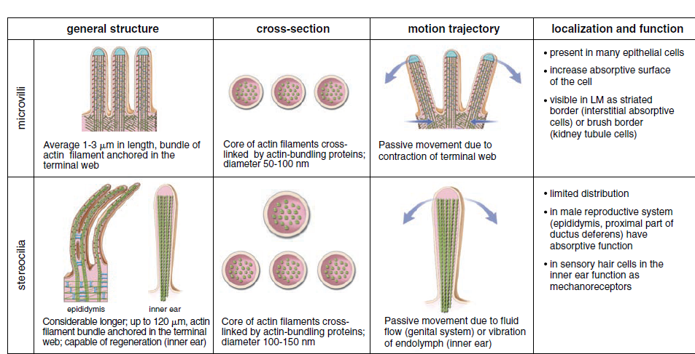
Microvilli and Stereocilia

Slide 35
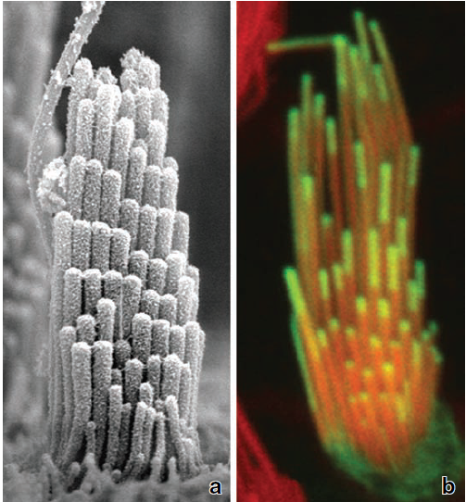
Dynamic turnover of an internal architecture of sterocilia:
a. This scanning electron micrograph shows stereocilia of sensory epithelium of the inner ear. They are uniform in diameter and organized into ridged bundles of increasing heights. 47,000x.
b. Confocal microscopy image shows incorporation of the -actin green fluorescent protein (GFP) and espin-GFP to the tip of the stereocilia (green). Actin filaments in the core of the stereocilia are counterstained with Rhodamine/phalloidin (red).

Slide 36
TIP 1: Distinguishing Features of Epithelial Tissues
  High cellularity
  Matrix paucity
  Avascularity
  Cohesiveness
  Cellular polarity
  Morphological diversity
  Superficial location
  Diverse physiological functions
  High Regenerative capability
  Constituting Parenchyma of organs and glands
  Good innervation
  Diverse embryological origin

Slide 37
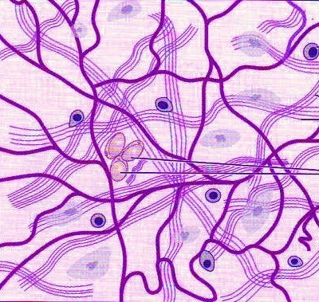
CONNECTIVE TISSUE
Connective tissue consists of cells widely separated from each other, and embedded in extracellular matrix consists of amorphous substance (ground substance) and fibers
Connective tissue supports, binds and connects various tissues and organs
Connective tissue is rich in blood vessels, lymphatics and nerves. It carries O2 and nutrients to cells in various tissues of the body
Fibers
Ground substance
Cells

Slide 38
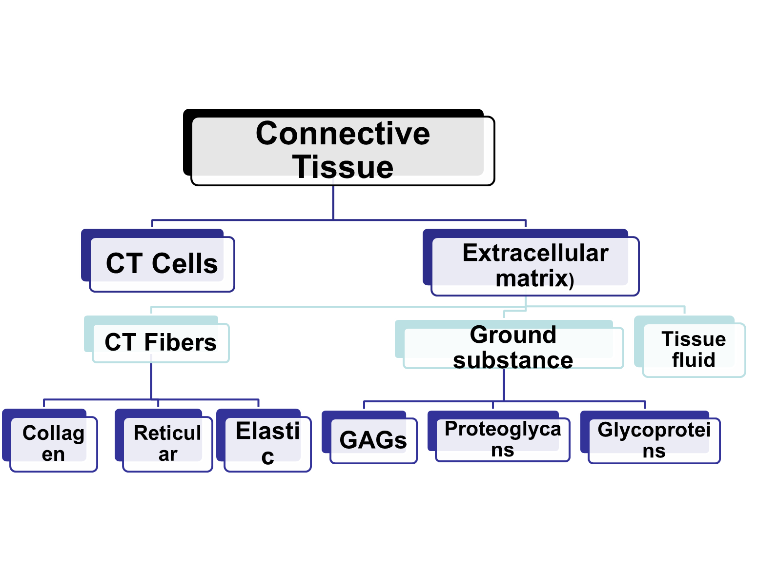
ORGANIZATION of CT

Slide 39
Distinguishing Features of Connective Tissues
  Less cellularity
  Matrix abundance
  High vascularity
  Morphological diversity
  Wide distribution
  Subepithelial location
  Functional diversity: including structural, nutritive and metabolic supportive functions
  Regenerative capability
  Cellular variety
  Constituting stroma of organs and glands
  Heavy innervation
  Mesenchymal origin

Slide 40
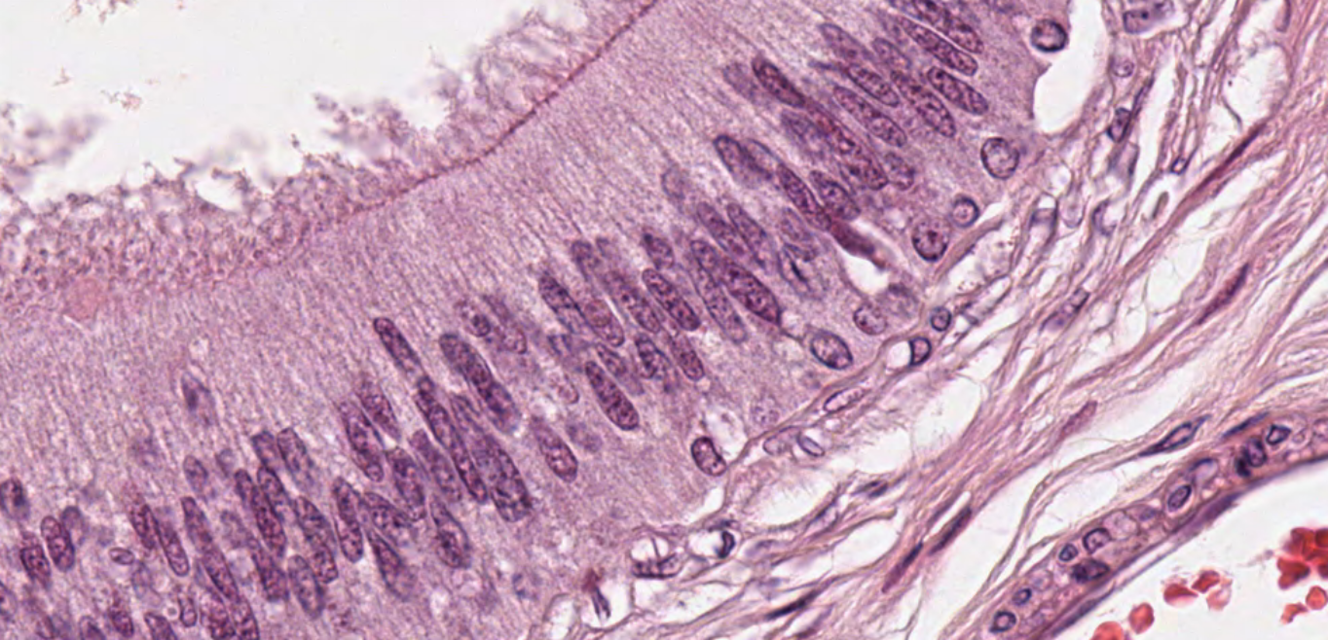
Epithelium and CT
CT
CT

Slide 41
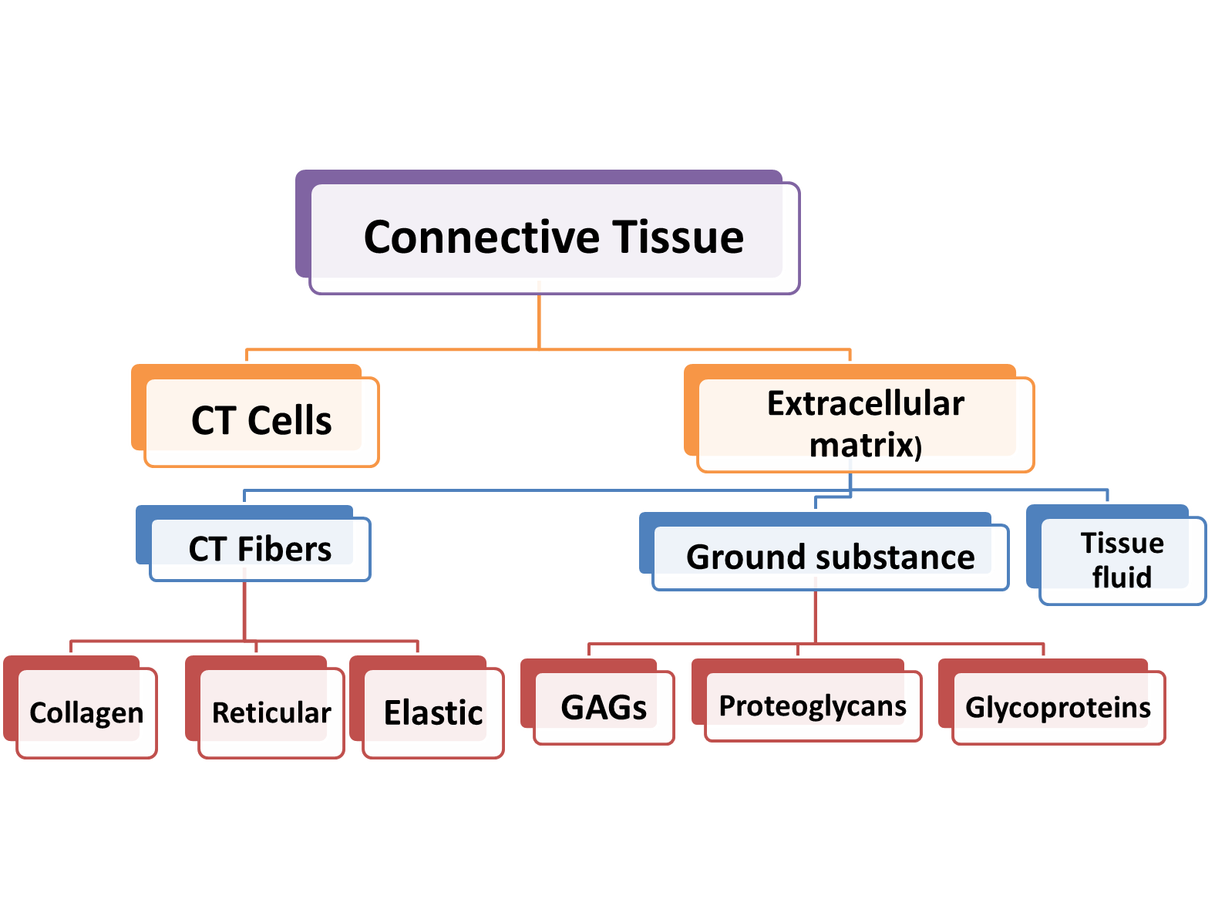
ORGANIZATION of CT

Slide 42
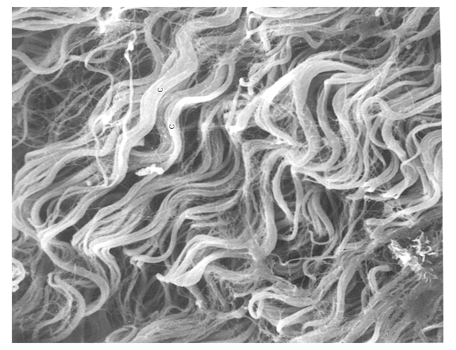
Fibers in Fibrous Connective Tissue:
Collagenous Fibers
Reticular Fibers
Elastic Fibers
Collagen Fibers as seen by scanning electron microscope

Slide 43
Collagenous Fibers (KOL-a-jen; colla = glue, gen= produced)
tough, firm, inelastic fibers which resist the tensile forces upon the tissues (flexible but with extremely high tensile strength), also called white fibers.
the most common fibers in connective tissue and the most abundant proteins in the body.
Although fresh collagen fibers are colorless strands, when present in large numbers (eg, in tendons) they appear white.
The highly regular orientation of subunits in collagen fibers makes them birefringent under the polarizing microscope.
In the light microscope, collagen fibers are acidophilic; they stain pink with eosin, blue with Mallory trichrome stain, green with Masson trichrome stain, and red with Sirius red.

Slide 44
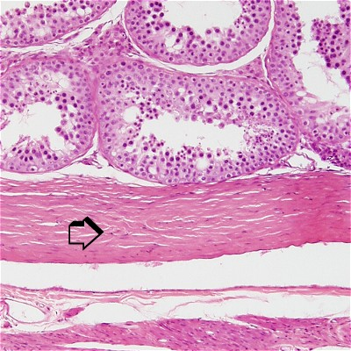
45

Slide 45
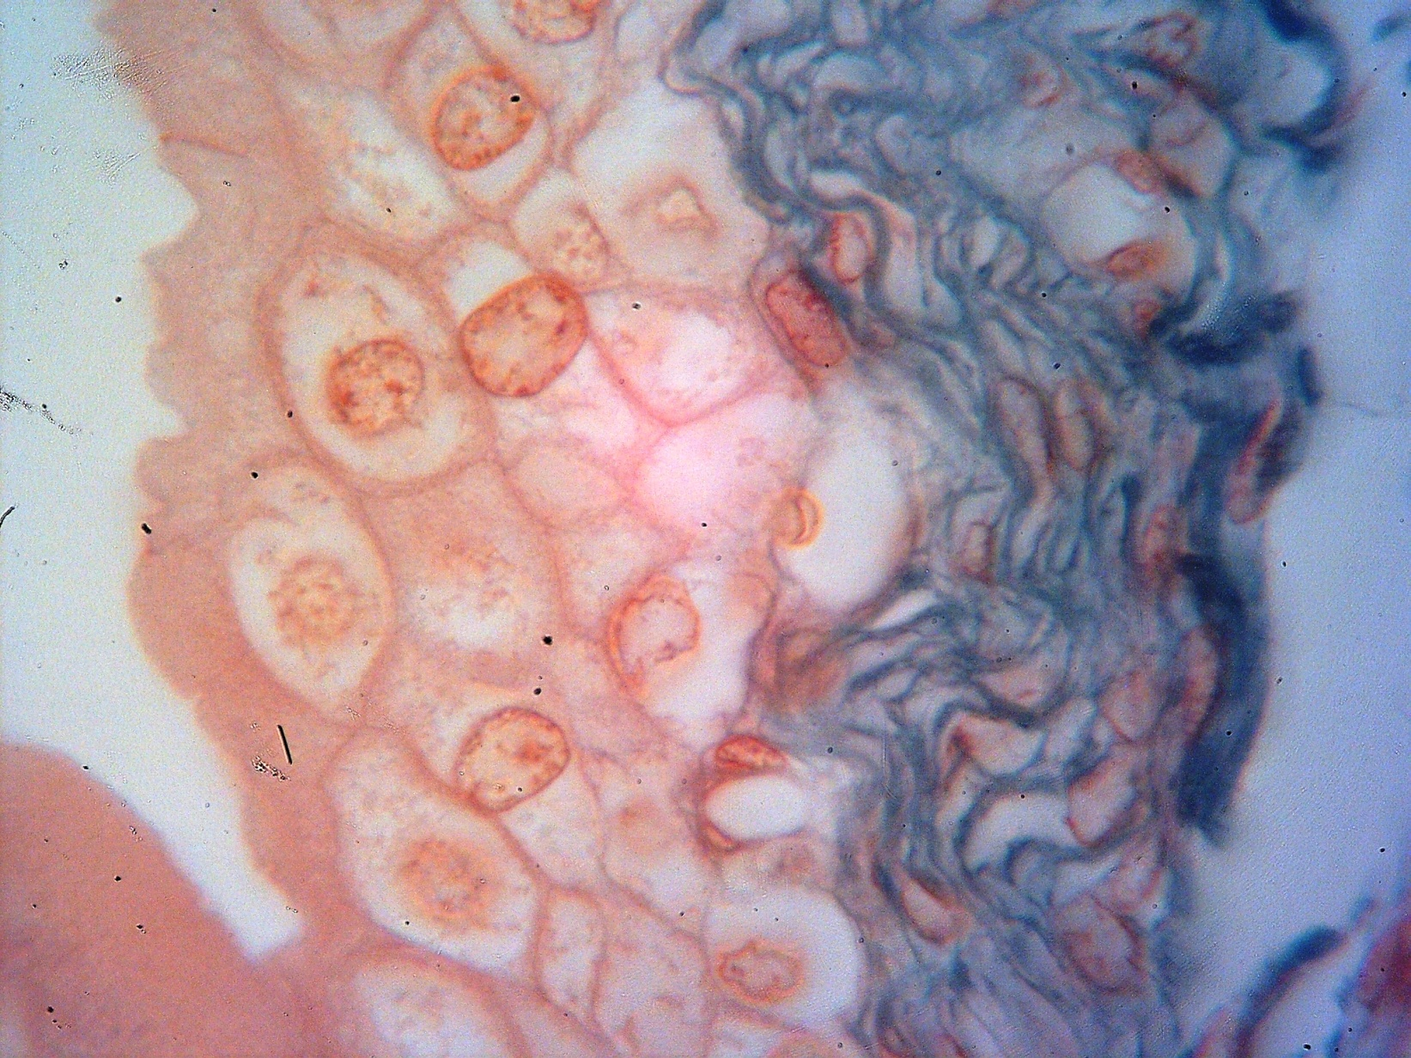
Blue stained collagenous tissue in Lamina propria

Slide 46
Collagenous Fibers
synthesized by different types of cells in d/t tissues: fibroblasts, chondroblasts, osteoblasts, odontoblasts, reticular cells, adipocytes, smooth muscle fibers, etc
ultrastructurally consists of:
    Collagen macromolecules called Tropocollagens running parallel and overlapping each other.
        Tropocollagens form collagen fibrils, each of which represents a structural unit (the unit fibrils of collagen).
      Each unit fibril shows transverse bands.
      Each tropocollagen molecule is a right-handed triple helix formed by intertwining of three procollagen α-polypeptide chains.

Slide 47
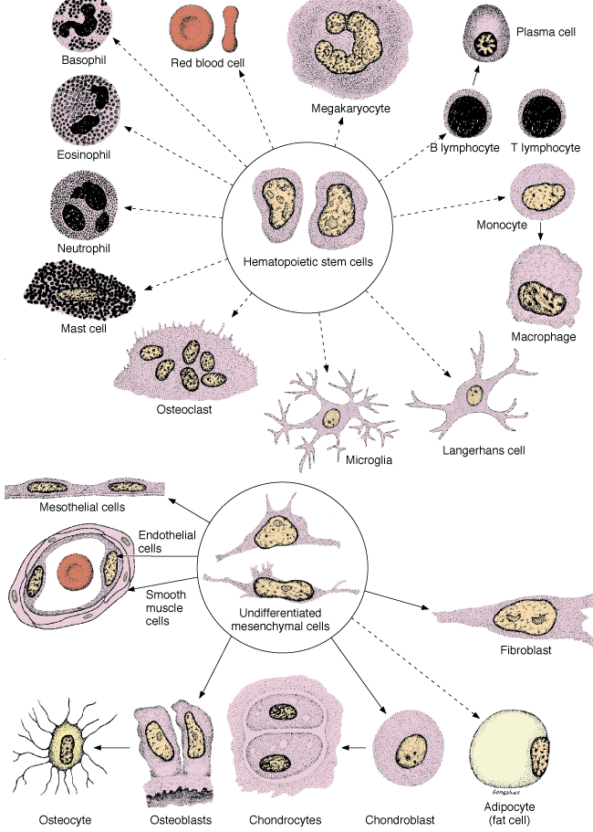
Types, Sources and Lineages of CT Cells
Source: M. Ross

Slide 48
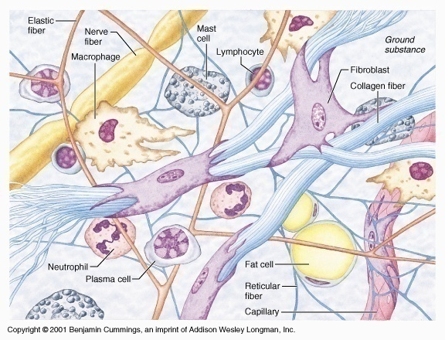
Composition of ordinary connective tissue (CT Proper)

Slide 49
Connective tissue
Connective Tissue consists of
Fibers
Cells
Extracellular matrix
+
Ground substance
Ground substance
Cells
+
Fibers

